Slide 1
Assignment 5
Frieda R., Kelsey Z, Rickenson R., Thomas E.

Slide 2
Overview
Value proposition
Interface and rationale
Prototype
Tasks
Experiment and Results
UI Suggestions

Slide 3
Give your projects some direction!
Many people struggle with choice paralysis when it comes to starting and finishing creative tasks. Amble provides direction by giving users a roadmap to achieve their artistic goals.

Slide 4
Interface
Originally between a native mobile app with neural network theme or an AR app
Narrowed down to native mobile app

Slide 5
Rationale
Allows the most functionality and ease of use
Most users will already have a smartphone
Possible to incorporate AR in the future.

Slide 6
Lo-fi Prototype

Slide 7
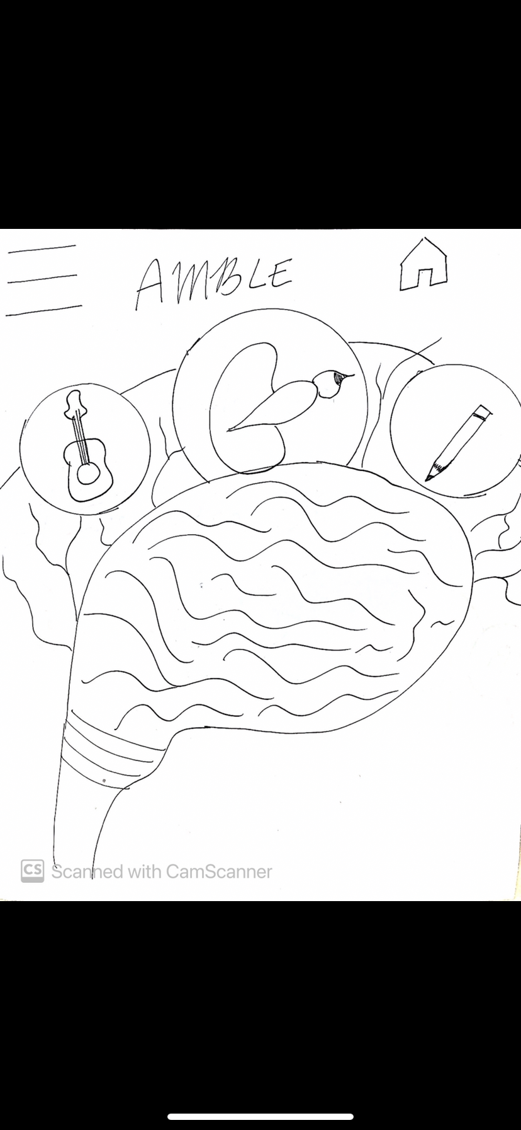
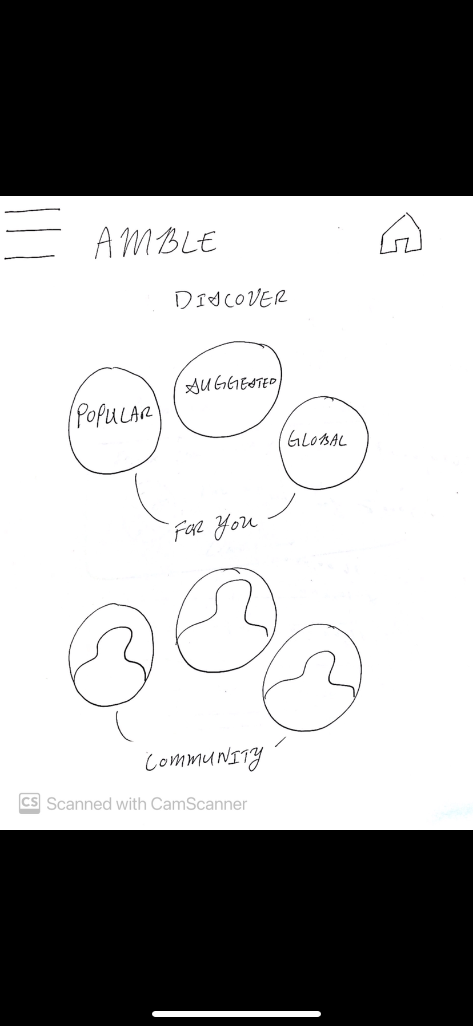

Slide 8
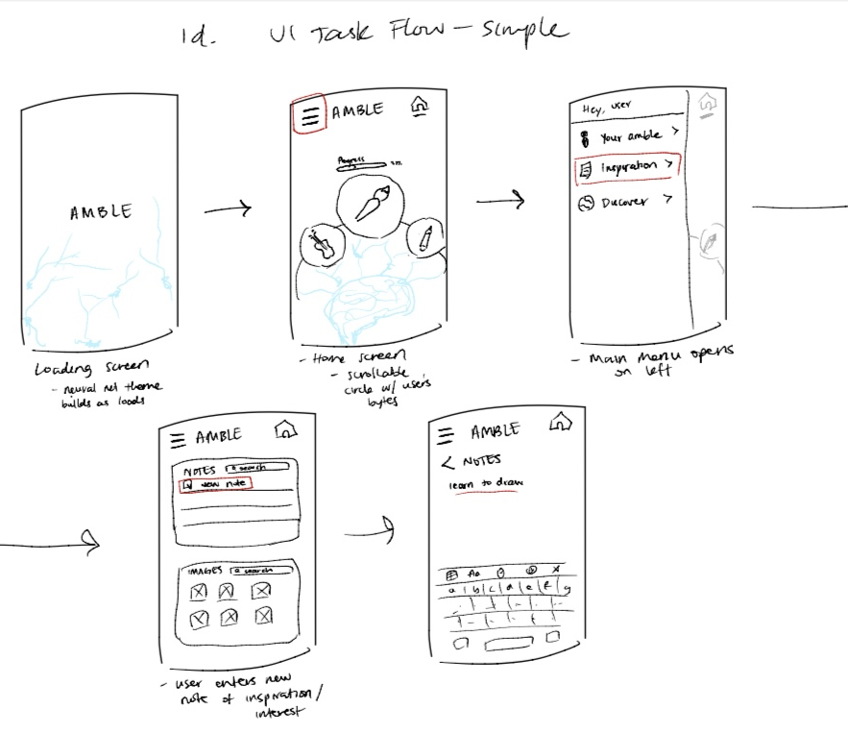
Simple Task
Save ideas in one location

Slide 9
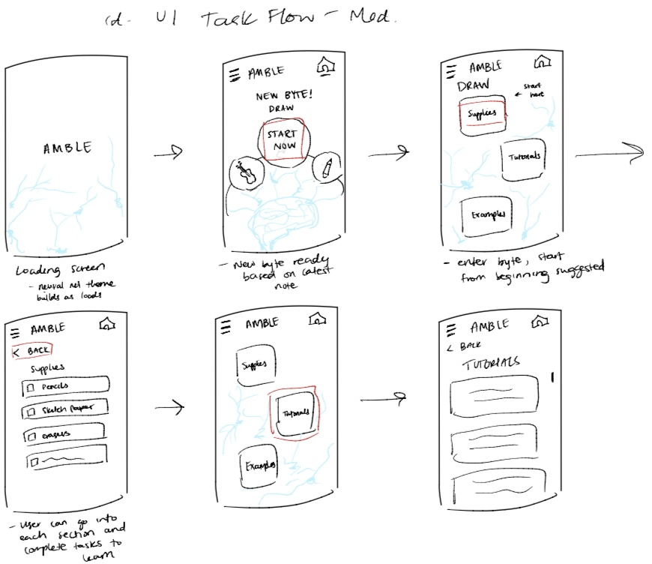
Moderate Task
Explore interests in a friendly, easy to use manner (e.g. painting)

Slide 10
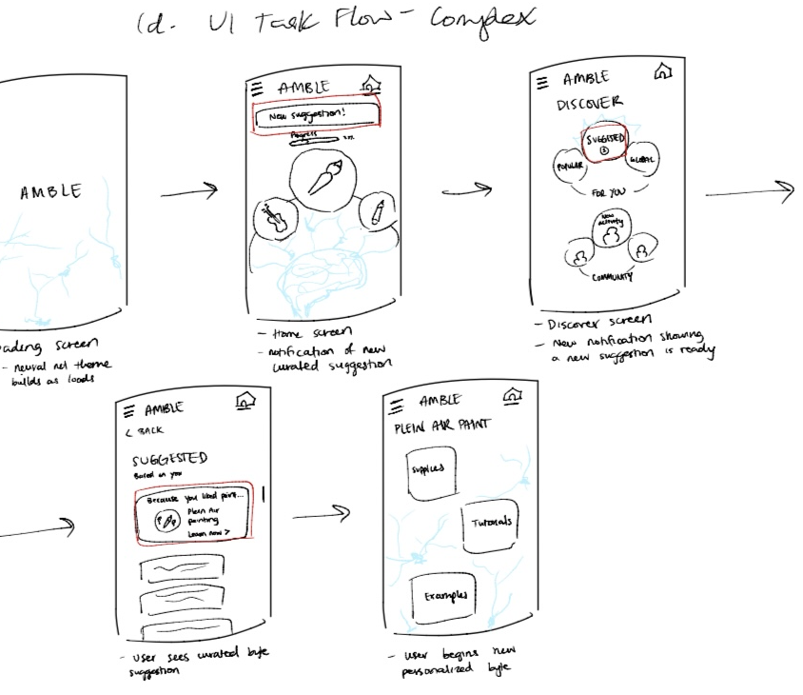
Complex Task
Improve on hobbies by receiving suggestions about the direction to take one’s artistic interests

Slide 11
Experimental Method
In person, with marvel app
We had each participant do the following for each task:
Work through the task
Describe the experience
Work through the task again to see if there were improvements in the ease with which they completed it

Slide 12
Experimental Results (P7) Recent finance grad who is a private client associate
Task 1:
Clicked on the pencil to try to take a note, (thought pencil was the note taking area)
Task 2:
Easily clicked on paint button
Thought you were learning by doing the skills on the actual platform, not in real life
Task 3:
Easily clicked on suggestions button
Liked the suggestions feature

Slide 13
Experimental Results (P8) recent grad doing backend software development who has worked in healthcare
Task 1:
Expected a pencil or pen icon for taking notes and clicked on the wrong icon
Task 2:
Tried the paint icon first
Found the “start here” text helpful
Tried to click on the check boxes
Task 3:
Clicked on button that says “new suggestions”
Missed the final clickable button

Slide 14
Experimental Results (P9) recent grad working in finance & marketing at a government bank as a senior financial analyst
Task 1:
Went immediately to the menu icon in top left
Found finding the notes section very easy
Task 2:
Found the order of supplies, tutorial, examples good and natural
Task 3:
Noticed the “New suggestion” button easily

Slide 15
Experimental Results
Efficiency
People generally struggled with finding the notes section even though it was the simple task (2/3 of participants)
Participants generally appreciated directives (e.g. “start here”) but had conflicting views about the effectiveness of labels
Sometimes difficult to distinguish letters and borders

Slide 16
Experimental Results
Learnability:
Participants generally improved the second time around
Complaints about the number of steps

Slide 17
Interesting Quotes
“why do I need to collect supplies if it’s an app, oh i thought we were going to be painting on the app” – P7
“Oh what, weird” – P7
“the painting icon says ‘paint’ on hover” – P9
“I don’t see a note-taking option, and I know three bars means more options” – P9

Slide 18
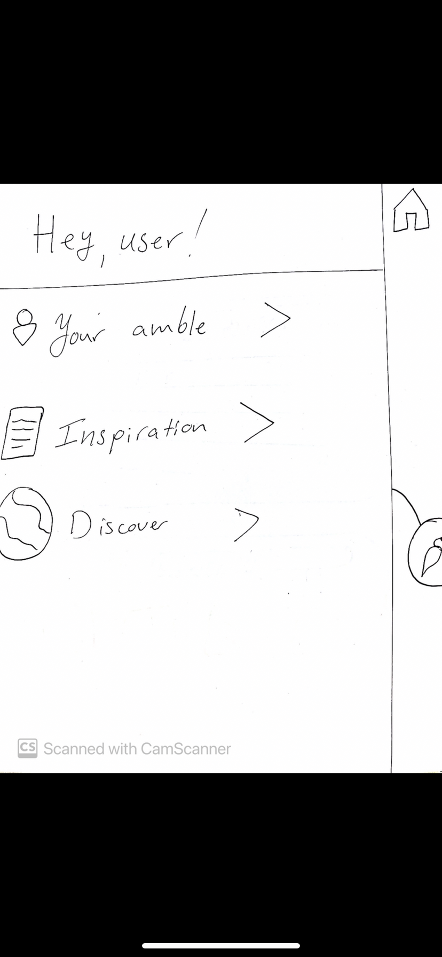
Suggested Ui Changes
Icons and labeling should be more intuitive and should not conflict
1. Use directives and wording that is clear (e.g. what does “inspiration” really mean?)

Slide 19
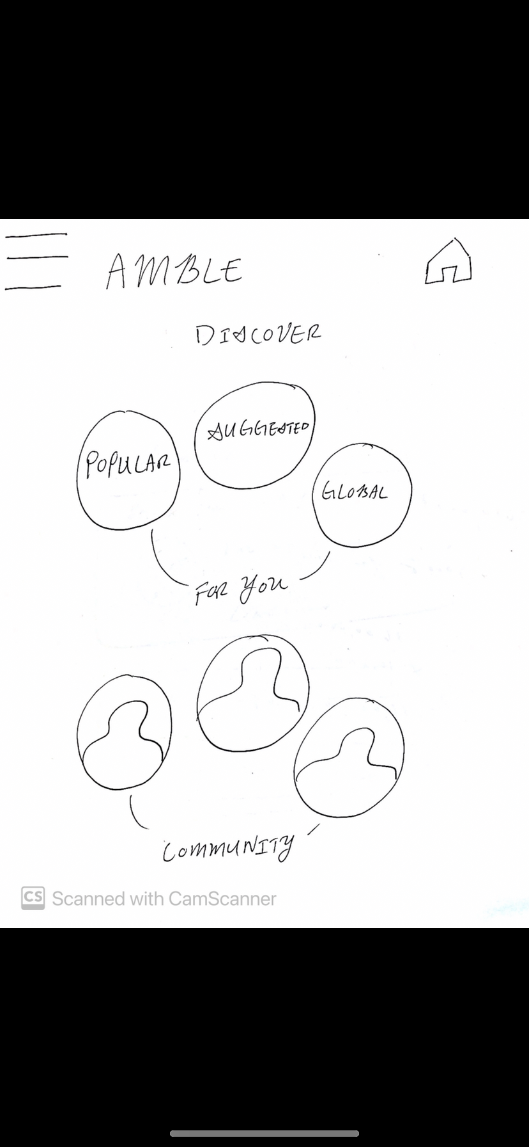
Suggested Ui Changes
Use consistent font and create clear borders
Nothing too flashy
Add color to help distinguish between objects

Slide 20
Summary
Native app is best choice
UI needs to consistent and clear
Simple to learn

